Slide 1
Grand Rounds
Case 3
“Sharon”
“Why are my gums so red”

Slide 2
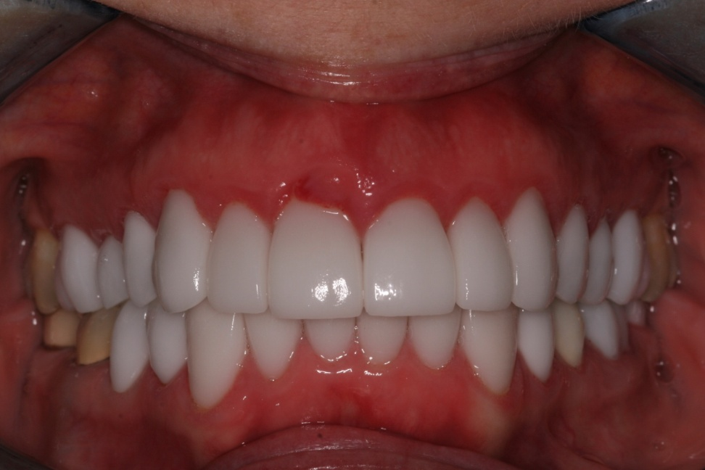
Sharon is a 48 year old Caucasian female with a chief complaint of bleeding, red tingling gums. She has come to you for a second opinion (third opinion) regarding this problem
Problem started after the placement of porcelain veneers. First veneers placed in September 1994 on #7,8,9 and 10 without incident.
In 2007, these veneers were replaced and crowns placed on upper molars and the lower teeth as seen here in this photo ( the whiter ones)

Slide 3
Gums bled after these restorations were placed; attributed to a reaction to non-eugenol-based temporary cement
Veneer on #8 was cracked and replaced. Eventually this one was replaced 4 times.
July 2008 sought a second opinion- new dentist replaced all the old veneers. Told there was “black material under the veneers”. Laser therapy to gingiva.
New bite “did not feel natural”; several occlusal adjustments made.

Slide 4
Referred to a periodontist who removed “granuloma” from labial of #8. He was concerned about possible root fracture. Granuloma returned two months later.
Antibiotic prescribed ( local and systemic). Lesion still recurred.
Referred to an oral surgeon who excised the tissue.
Gums still bleed when she flosses.

Slide 5
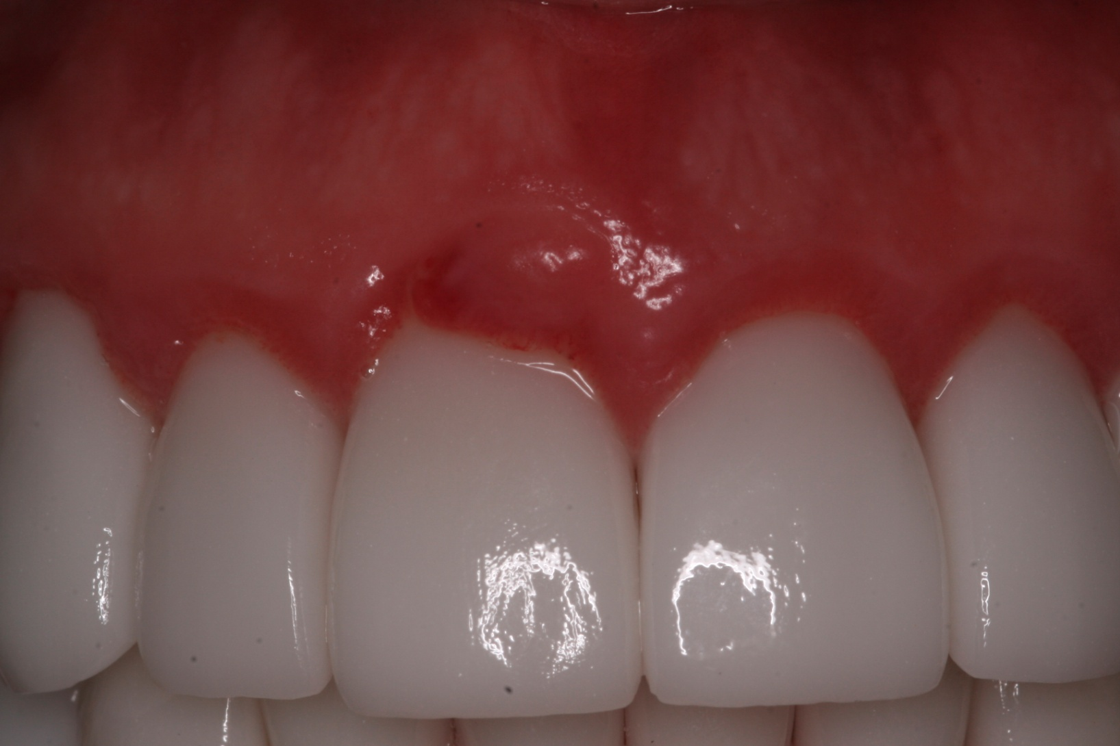

Slide 6
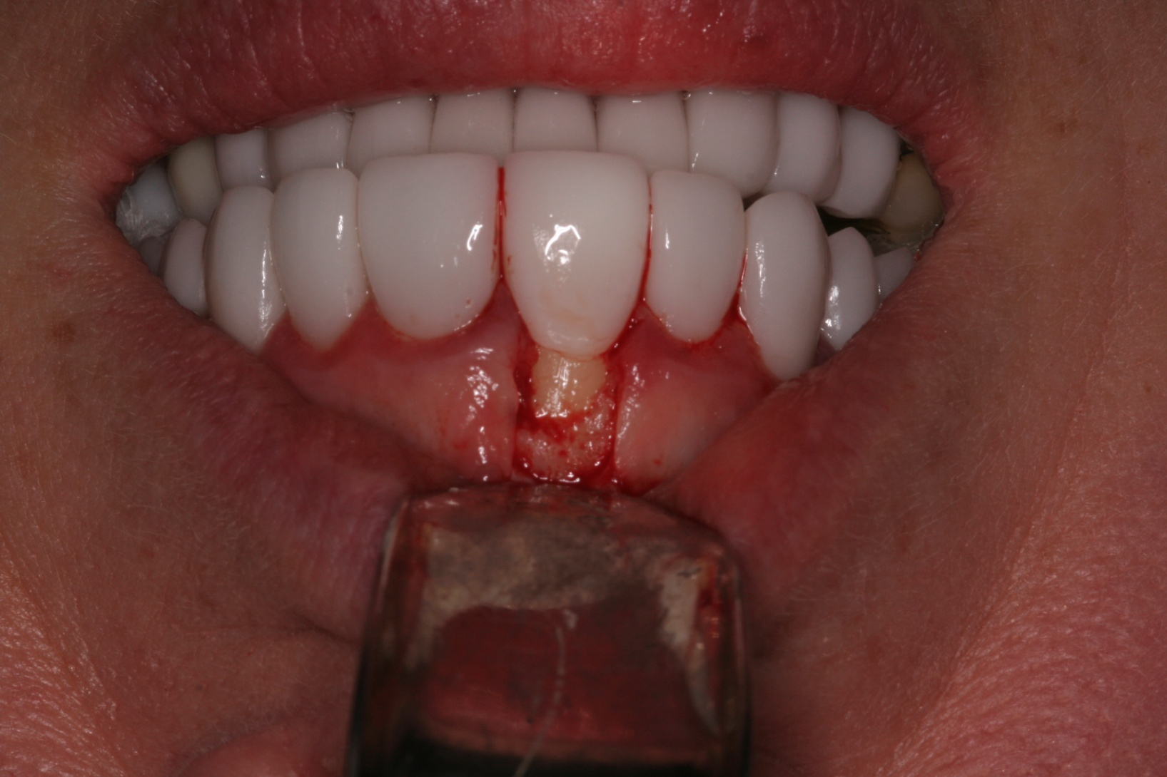
After excisional biopsy of the papule on the labial aspect of # 9.

Slide 7
Medical History
Social History
Psoriasis diagnosed in 1976
Appendectomy, tonsillectomy, 2 normal deliveries of term infants
D and C; uterine ablation surgery
Labs:
  WBC-6.2; HGB 12.8; platelets 248
  Urinalysis normal
  Fasting glucose 87
  All else WNL
Married with 2 teenage children
Smoked half pack cigarettes per day in her twenties
Drinks 6 glasses of wine per week

Slide 8
Oral Hygiene
Flosses 2-4 times per day
Uses plastic dental pick too- gums gush blood
Brushes 2-4 times per day with regular Crest
Uses Waterpik twice per week

